Slide 1

MCA Major Project End Term Evaluation
Data Analysis Project
Submitted By
Dharmesh Singh Choudhary
Reg No. 23FS20MCA00115
Under the guidance of
Dr. Chandrashekhar Patel, Associate Professor
Department of Computer Applications
Manipal University Jaipur
Rajasthan, India

Slide 2
Outline
Introduction
Motivation
Objective
Methodology
Implementation
Result and Analysis
Output
Conclusion
Future Scope

Slide 3
Introduction
In today’s digital era, businesses generate massive sales data but struggle to derive meaningful insights.
This project focuses on analyzing sales performance against budget using Python, Power BI, and Excel.
It bridges the gap between raw data and strategic business decisions.
Objective: Help businesses make informed, data-driven decisions by visualizing KPIs like sales, budget variance, and growth trends.

Slide 4
Motivation
Many companies still rely on outdated manual methods (like spreadsheets) to analyze sales, which are time-consuming and error-prone.
Inaccurate forecasting and poor data integration hinder business performance.
There is a need for an efficient, automated system to identify patterns, forecast sales, and improve operational efficiency.
The project aims to leverage modern tools to address these challenges and unlock hidden insights from fragmented sales data.

Slide 5
Objective
Perform comprehensive analysis of sales data to uncover trends, anomalies, and growth opportunities.
Compare actual sales against budgeted targets to evaluate performance.
Build dynamic dashboards for real-time data exploration.
Empower business users with visual insights to support strategic planning and decision-making.

Slide 6
Methodology
Data Collection:
Sales and budget data were collected from Excel sheets (Database.xlsx) including product names, monthly figures, and region-wise performance.
Preprocessing:
Using Python (pandas, numpy), the data was cleaned by handling missing values, correcting data types, and normalizing inconsistent entries.
Exploratory Data Analysis (EDA):
Libraries such as matplotlib and seaborn were used to identify trends, outliers, and patterns in the data.

Slide 7
Methodology
Data Modeling & Visualization:
Cleaned data was imported into Power BI.
Power Query transformed the dataset to support dashboard elements.
Relationships were established between tables for slicing and filtering.
Computation of KPIs:
DAX formulas were written to calculate metrics like total sales, budget variance, and month-over-month growth.
All computed metrics were verified against raw data and stakeholder expectations

Slide 8
Methodology
Insight Extraction:
Final dashboards enabled easy interpretation of performance by product, region, and time.
Validation: - All computed metrics were verified against raw data and stakeholder expectations.

Slide 9

Implementation
The project implementation was carried out in distinct phases:
Requirement Analysis:
Identified business needs, defined KPIs, and planned deliverables and timelines.
Data Acquisition:
Collected structured Excel datasets on sales and budgets across regions and product categories.
Data Cleaning:
Removed duplicate records, handled nulls, corrected data types, and standardized labels.

Slide 10
Implementation
4. Python-Based Analysis:
Used Python in Jupyter Notebook to perform variance analysis, generate plots, and calculate performance metrics
5. Power BI Modeling:
Loaded cleaned data, built relationships, and transformed fields using Power Query.
6. Dashboard Development:
Created visualizations such as:
Line charts for time trends
Bar charts for product performance
Pie charts for customer segmentation
Heatmaps for variance tracking

Slide 11
Implementation
7. Testing and Validation:
Verified data integrity and usability of visuals.
8. Deployment:
Final Power BI dashboard delivered with full interactivity for business users.

Slide 12
Result and Analysis
The data analysis led to several important discoveries:
Sales vs Budget:
Q2 months underperformed due to seasonal lows.
Q4 showed highest sales, likely influenced by year-end promotions.
Regional Analysis:
South region led in total sales but had inconsistent variance.
West region consistently missed targets, requiring strategic review.

Slide 13
Result and Analysis
Product-Level Insights:
Products A and D exceeded their targets.
Product C was underwhelming despite budget allocation, suggesting misalignment in marketing or pricing.
Growth Patterns:
Promotions led to >20% growth in some months.
Mid-year stagnation signals a need for refreshed marketing campaigns.
Business Implications:
Resources can be shifted to high-growth areas.
Poorly performing products may require revision or replacement.
More accurate forecasts can be developed using these findings.

Slide 14
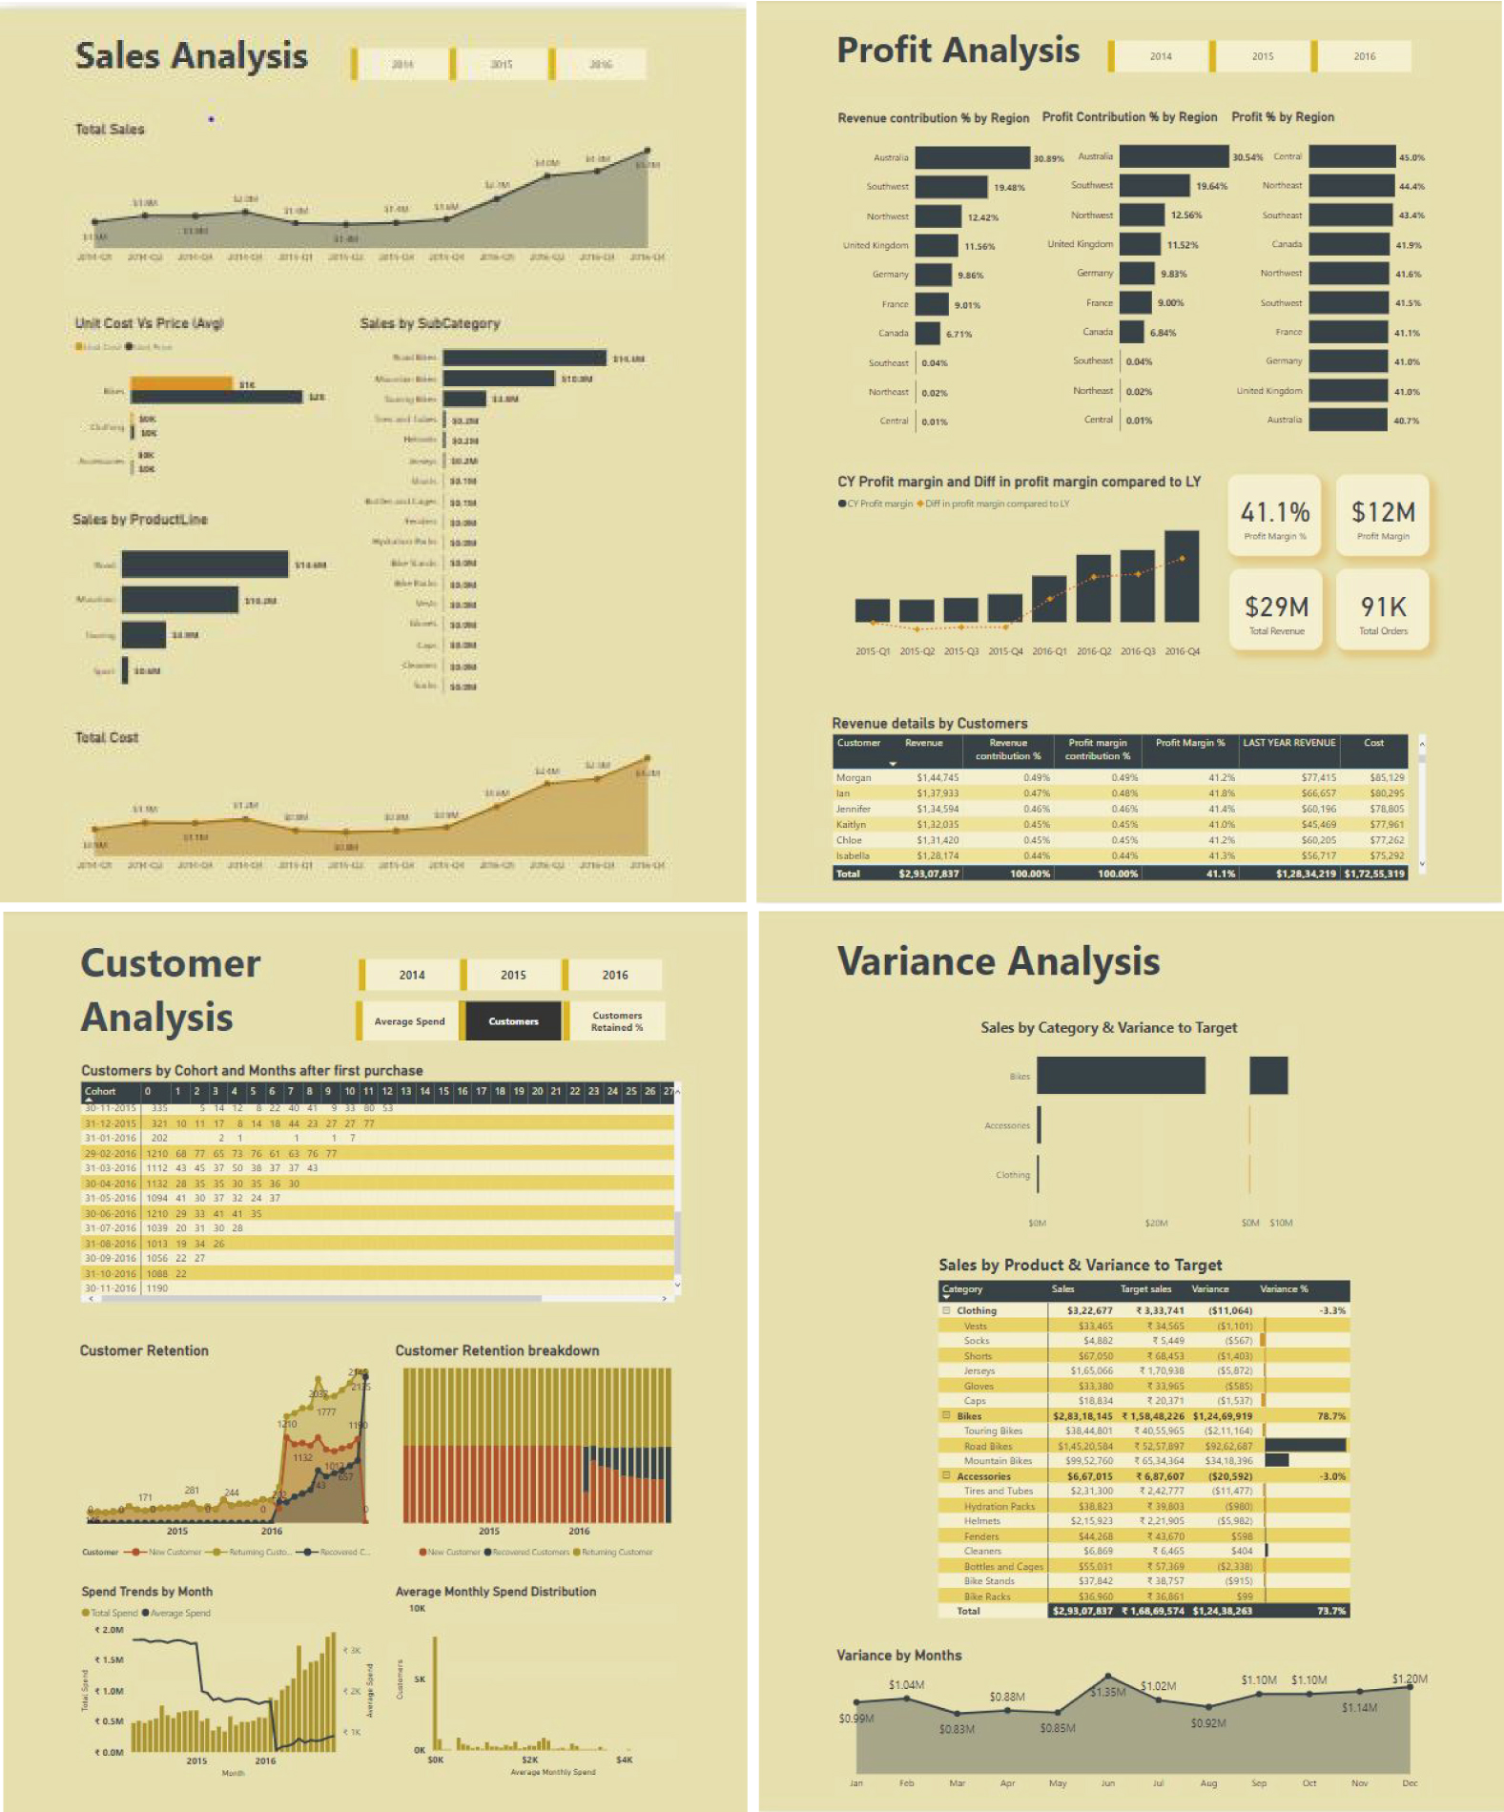
Outputs

Slide 15
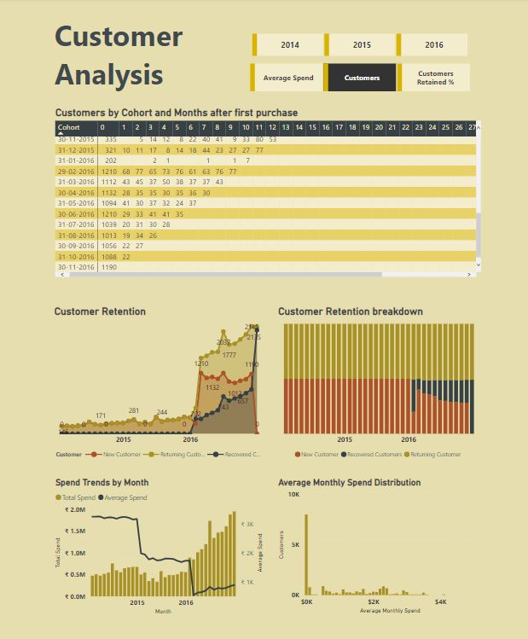
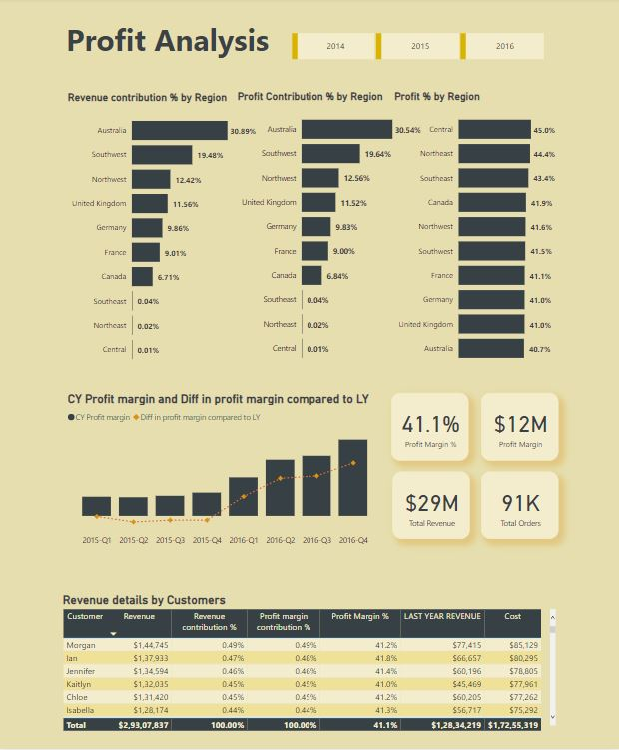
Outputs

Slide 16
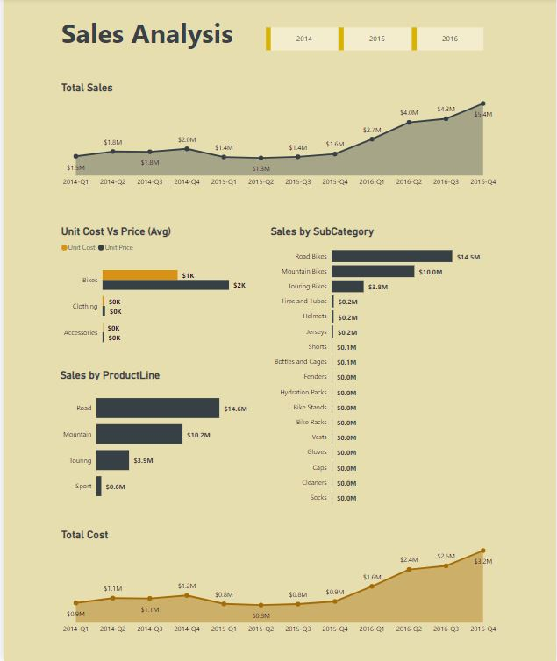
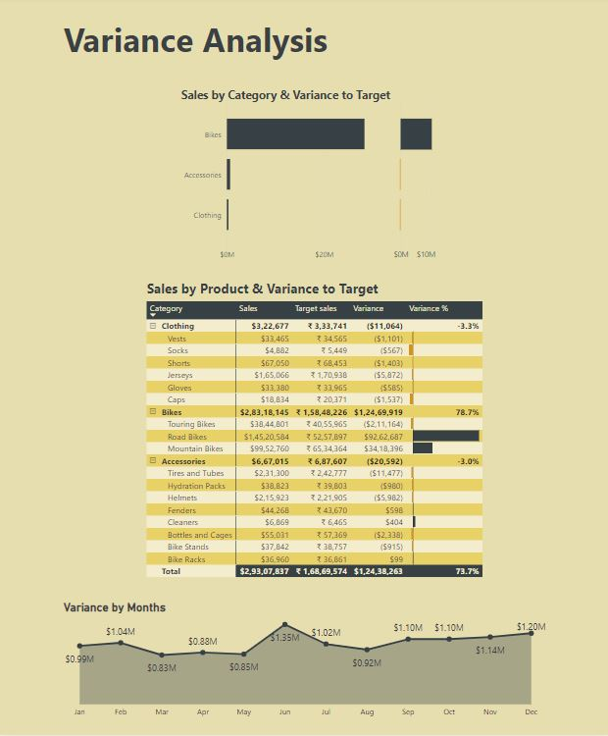
Outputs

Slide 17
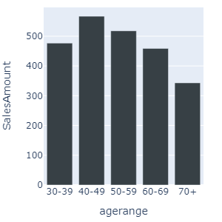
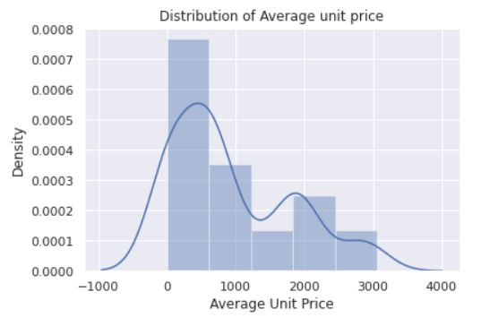
Outputs

Slide 18
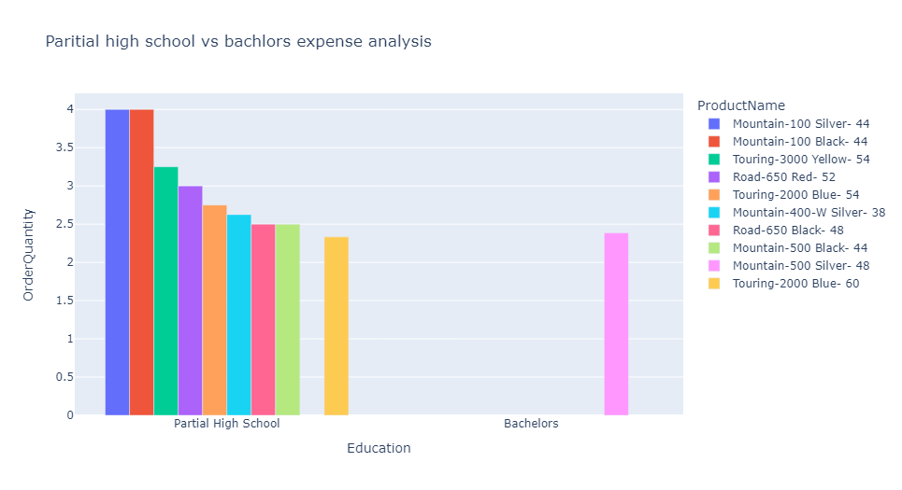
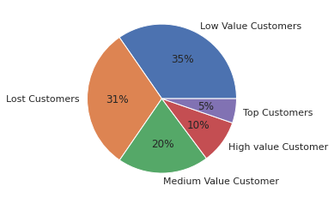
Outputs

Slide 19
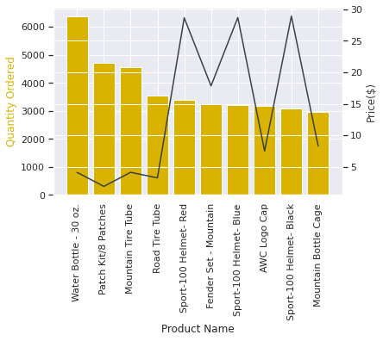
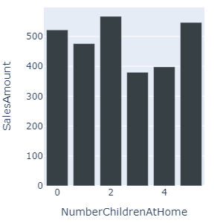
Outputs

Slide 20
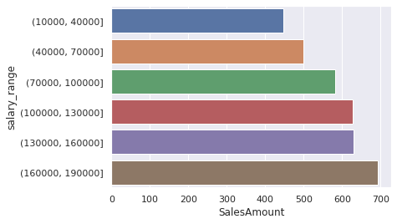
Outputs

Slide 21

Conclusion
The project successfully demonstrated how sales and budget data can be transformed into strategic insights using Python and Power BI.
It provided a clear view of:
Product and region-wise performance.
Trends and variances over time.
Areas requiring improvement or investment.
The project empowered stakeholders with a self-service analytics platform, replacing manual reporting with interactive dashboards.
The approach highlights how data science supports better forecasting, inventory management, and marketing strategy.

Slide 22
Conclusion
Even with some limitations (e.g., limited dataset, tool constraints), the outcomes offer real business value.

Slide 23
Future Scope
There are several potential directions for expanding this work:
Predictive Analytics:
Integrate machine learning models like ARIMA, Prophet, or LSTM to forecast sales and trends.
What-If Simulations:
Use scenario modeling to test pricing, marketing, and supply chain impacts.
Real-Time Integration:
Connect dashboards with APIs for live sales feeds and automatic updates.
External Data Enrichment:
Include customer sentiment, competitor analysis, or macroeconomic indicators.

Slide 24
Future Scope
5. Enterprise Deployment:
Publish dashboards on Power BI Service with role-based access and mobile support.
6. Advanced Visuals and UX:
Introduce dynamic filters, forecast cones, and geographical heatmaps for deeper engagement.
7. Data Governance:
Enable version control, user auditing, and secure access to analytics assets.
These improvements can transform the project into a full-scale business intelligence (BI) system used enterprise-wide.

Slide 25
Thank You

